Slide 1
Financial Analysis of Different States
The project provides valuable insights into the financial performance of different states in India over a 40-year period. The analysis can help policymakers, economists, and researchers better understand the factors influencing the economic development of states and formulate effective strategies for sustainable growth.
Team Members: Arbaj Momin,
Ketan Thakkar,Tanvi Agrawal,
V.Maunica,Parshant Verma

Slide 2
Datasets: The Datasets include 8 financial factors that include Aggregate Expenditure, Capital Expenditure, Gross Fiscal Deficits, Nominal GSDP Series, Tax Revenues, Revenue Deficits, Revenue Expenditure, Social Sector Expenditure. All the Datasets consisted of columns like States and Years.
Objective: The objective of the project is to analyze the financial performance of different states in India from 1980 to 2016. This analysis aims to provide insights into the fiscal health, spending patterns, and revenue generation of each state over the 40-year period.
Significance: A financial analysis of different states over a 40-year period provides valuable insights into the economic performance, fiscal management, and policy effectiveness of each state. It helps identify trends, challenges, and opportunities for improvement, aiding policymakers, researchers, and stakeholders in making informed decisions for sustainable development and growth.

Slide 3
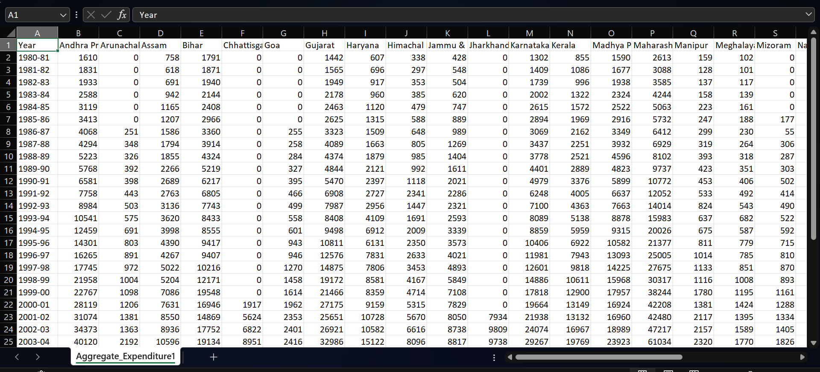
Overview of the Datasets
The Project includes 8 datasets. Each represent a financial factor over 40-year period. The financial factors include Aggregate Expenditure, Capital Expenditure, Gross Fiscal Deficits, Nominal GSDP Series, Tax Revenues, Revenue Deficits, Revenue Expenditure, Social Sector Expenditure.
Main columns in the Datasets are the Different States and Year columns:
Here’s an overview of the raw dataset

Slide 4
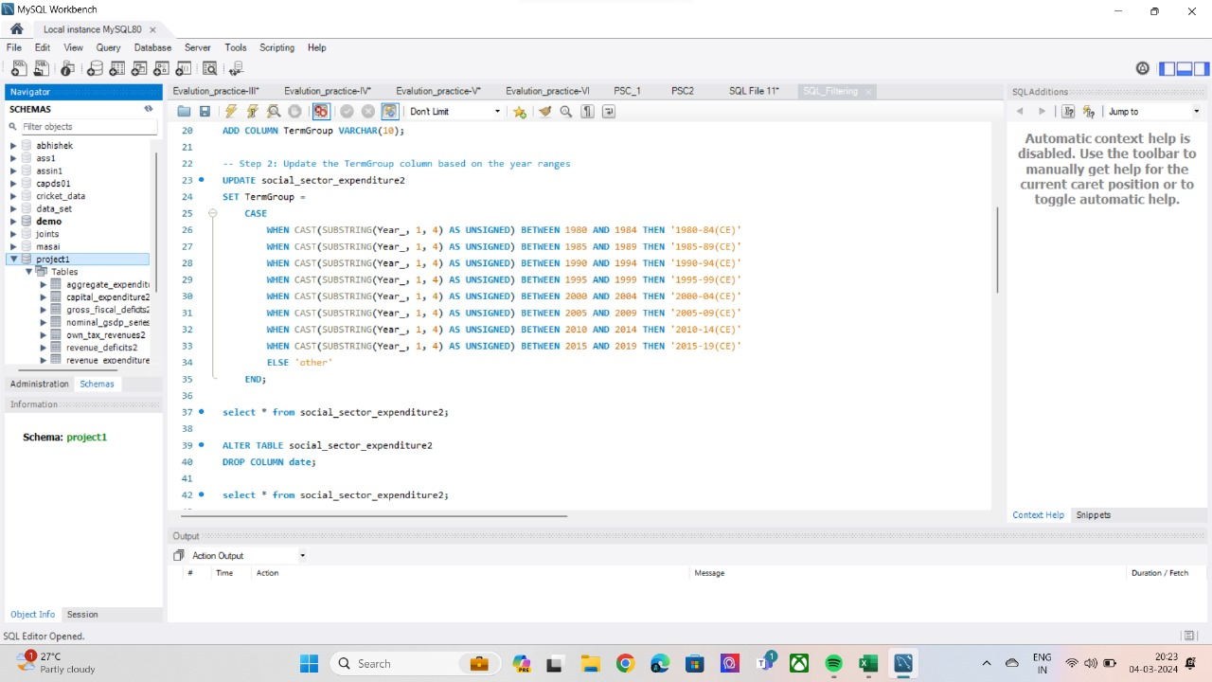
Methodology
Data Cleaning with Python: Used pandas and numpy to clean the data, including handling missing values, formatting issues, and outliers.
Data Preparation with SQL: Used SQL to load the cleaned data and group it into meaningful categories using case when statements. For example, group data into 5-year intervals.

Slide 5
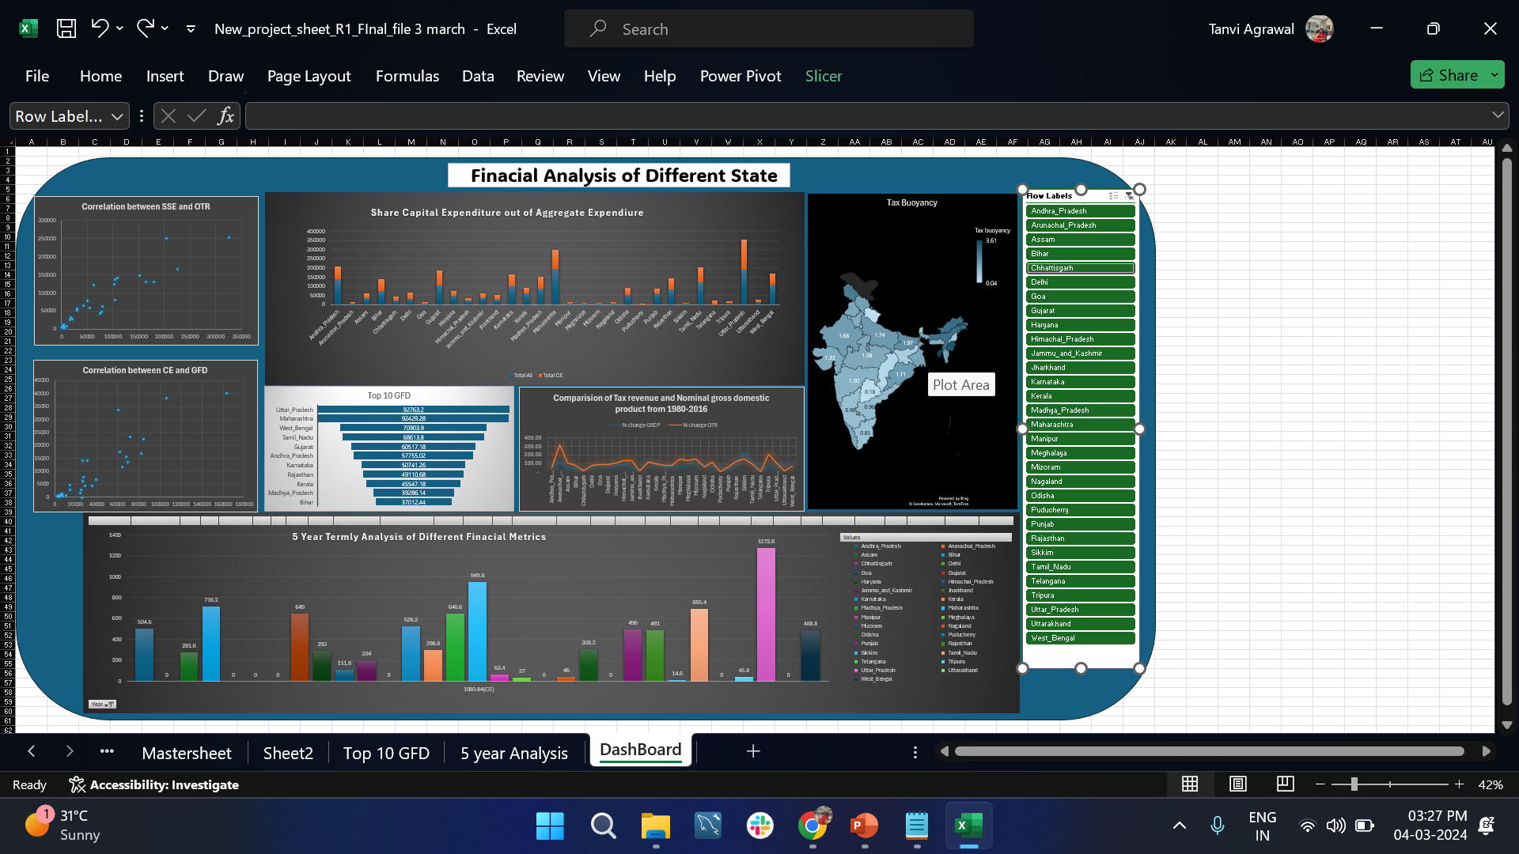
Creating Excel Dashboard:
Exported the analyzed data into Excel and established relationships between them using States as a common column.
Created pivot tables in Excel to summarize the data and calculate metrics.
Used pivot charts to visualize the data trends and relationships.
Used slicers to filter and interact with the data dynamically.

Slide 6
Insights
Most Important Financial Metrics: Based on the analysis, the two most important financial metrics are Gross Fiscal Deficits and Social Sector Expenditure. These metrics provide key insights into the fiscal health and management of states.
Correlation between Fiscal Deficits and Capital Expenditure: There is a positive correlation between Fiscal Deficits and Capital Expenditure, indicating that states with higher capital expenditure tend to have higher fiscal deficits. The correlation was 0.903.
5-Year Termly Analysis: The 5-year termly analysis of different financial metrics shows varying trends and patterns across states and over time, highlighting periods of growth and challenges in state finances.
Top 10 States with Highest Gross Fiscal Deficit: The analysis identifies the top 10 states with the highest gross fiscal deficit, indicating the states facing significant fiscal challenges.

Slide 7
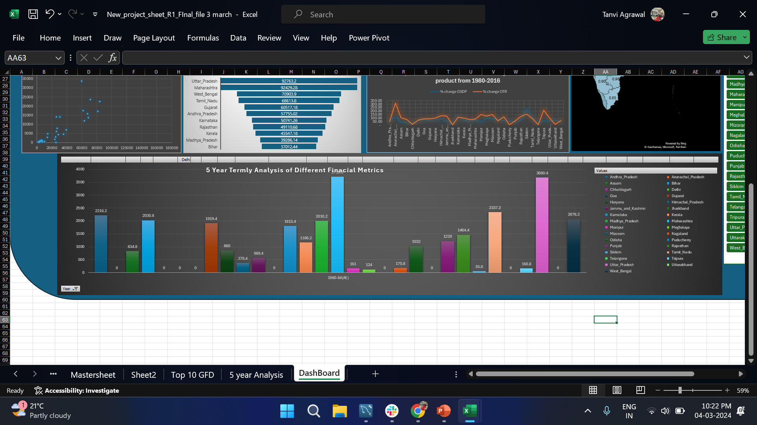
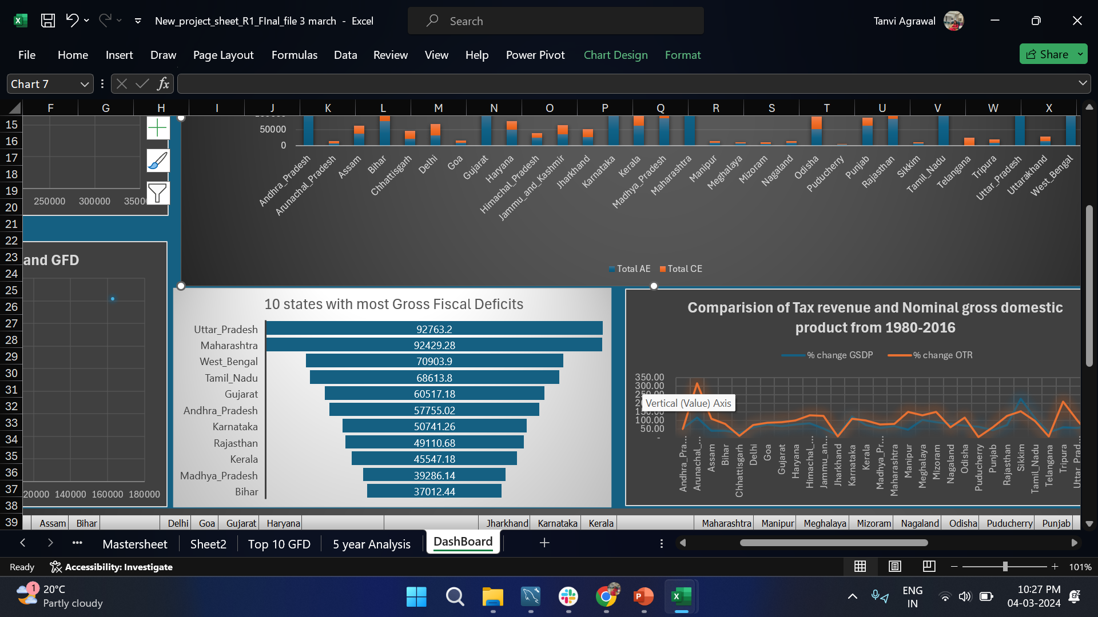

Slide 8
Correlation between Social Sector Expenditure and Tax Revenues: There is a positive correlation between social sector expenditure and tax revenues, suggesting that states with higher tax revenues tend to spend more on social sectors like healthcare and education. The correlation was 0.93.
States with Continuous 40-Year Trends: The analysis identifies the top 2 states with continuous 40-year downward and upward trends in Nominal GSDP Series and Gross Fiscal Deficits, providing insights into long-term economic and fiscal performance.
Tax Buoyancy: A high tax buoyancy indicates that tax revenue is growing at a faster rate than GDP, reflecting a strong tax base and potentially sustainable revenue growth.
Share of Capital Expenditure in Aggregate Expenditure: A higher share of capital expenditure suggests that the state is prioritizing long-term investments, which can contribute to economic growth and development over time.

Slide 9
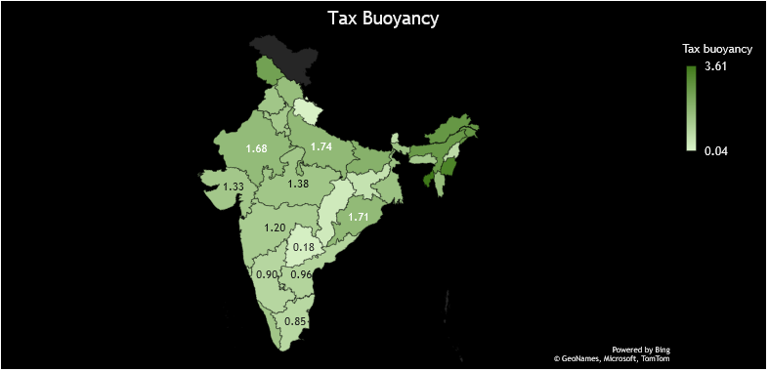

Slide 10
The SQL query used in the project:
This SQL query updates the TermGroup column in the social sector expenditure table based on the Year column. It categorizes the years into 5-year term groups, such as '1980-84(CE)', '1985-89(CE)', etc., and assigns them to the TermGroup column. The CASE statement checks the year range using the BETWEEN operator and assigns the corresponding term group. If the year does not fall into any specified range, it is categorized as 'other’.
In the same manner we have applied same query to all the datasets to group the data.

Slide 11
Conclusion
The analysis revealed significant variations in financial metrics among different states over the 40-year period.
Some states consistently maintained high levels of fiscal discipline, while others struggled with deficits and expenditure management.
There were notable correlations between certain financial metrics, such as between fiscal deficits and capital expenditure.
Social sector expenditure showed varying patterns across states, indicating different priorities and policies
Challenges and Lessons Learned:
Data Quality: Ensuring the quality and consistency of data across 40 years and different states was a challenge. It required thorough data cleaning and validation processes.
Analysis Complexity: Analyzing data for multiple states over a 40-year period involved complex calculations and comparisons, requiring careful attention to detail.

Slide 12
Future work
Deep Dive Analysis: Conducting a more detailed analysis of specific states or time periods to uncover deeper insights into their financial dynamics and trends.
Comparative Analysis: Comparing the financial performance of states based on various criteria such as population, GDP, or geographical location to identify best practices and areas for improvement.
Forecasting and Predictive Modeling: Using historical data to develop forecasting models for key financial metrics, helping states make informed decisions and plan for the future.
Policy Implications: Analyzing the impact of different policies and reforms on state finances to inform future policy decisions.
Stakeholder Engagement: Engaging with stakeholders such as policymakers, researchers, and the public to share findings and solicit feedback for future research and analysis.

